Slide 1
KALMAN FILTERING
Presented by:
Vimal Jaswal - B00122875
Masters of Engineering in Internet of things technologies
TU Dublin, Blanchardstown, Ireland.

Slide 2
Introduction
Research paper by Rudolf E. Kalman in 1960
A set of mathematical equations
Recursive data Processing Algorithm
Optimal estimation
Versatile
Estimation
Filtering
Prediction
Fusion

Slide 3
Kalman Filter
Kalman filtering
uses a series of measurements observed over time, containing statistical noise and other inaccuracies and produces estimates of unknown variables that tend to be more precise rather than on basis of single measurement.
Advantages
Optimal estimator
Provides a precise measurement for noises present in the system
Handles missing data
Handles the large uncertainty of the initialization phase
Fuses information from multiple-sensors

Slide 4
Kalman Filter Applications
Kalman Filter is a sensor fusion and data fusion algorithm used for:
State Estimation and multiple Sensors Fusion
Wireless sensor network (WSN), Localization, Tracking
Guiding Systems, Navigation, GPS
Autopilots
Radar Tracking Systems
Orbit tracking, trajectory tracking
Simultaneous Localization And Mapping (SLAM)
State estimators for Unmanned Aerial Vehicles (UAV)
Computer Graphics - 3D Modelling feature estimation

Slide 5
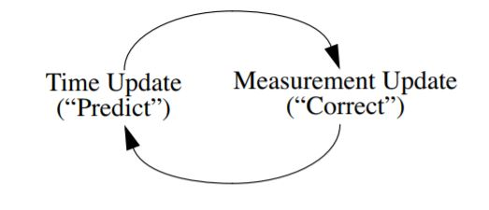
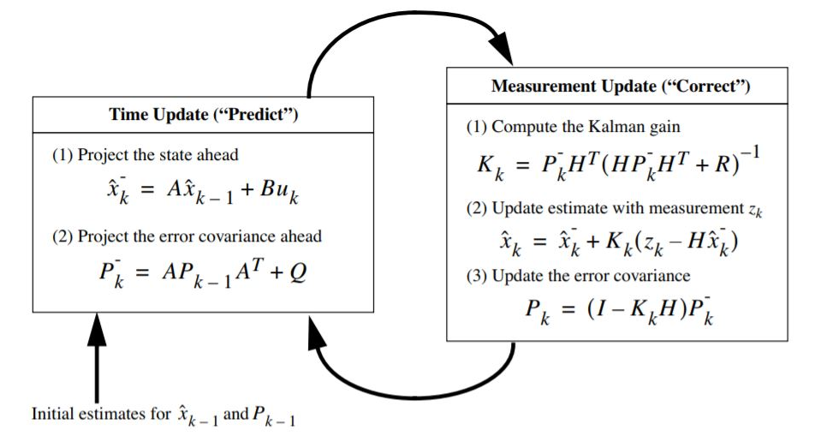
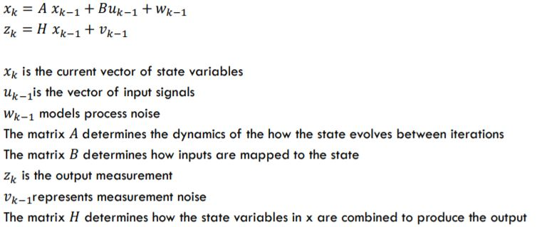
Discrete Kalman filter (Predictor- Corrector)
Q - process noise covariance R- measurement noise covariance
(Co- variance noise matrices might change with each time step/measurement/iteration)
P- covariance matrix of error in state estimate x
K- Kalman gain depend upon P and Q co-variances and H matrices
K changes in every iteration and determine weight for each prediction
posteriori estimate
priori estimates for the next time step

Slide 6
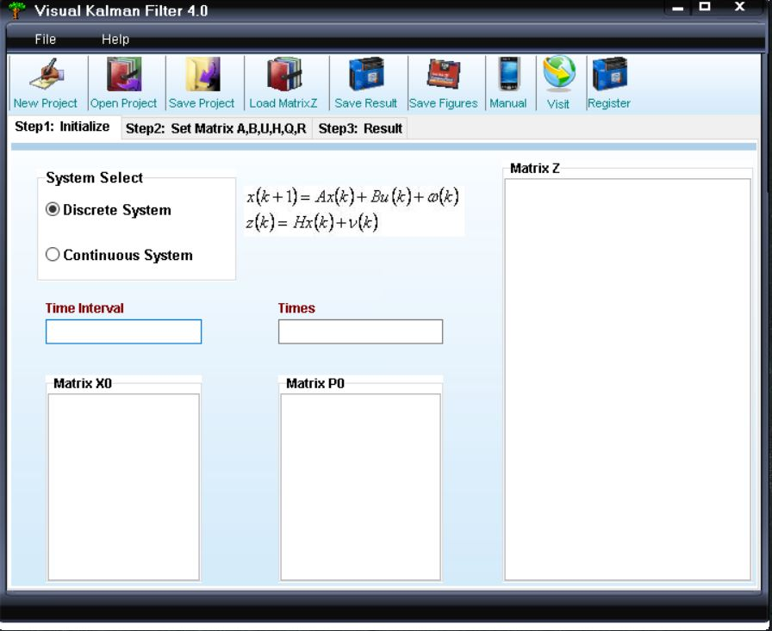
Kalman Filter Software Tools
Visual Kalman Filter
Kalman filtering designer that provides a visual method in windows to estimate the state of a process or removes noise from series of data
Support for discrete system and continuous system
Easy, lite and handy to use
MATLAB (Built-in features, EKF/UKF Toolbox for MATLAB V1.3)
GNU OCTAVE ( Autocovariance Least-Squares (ALS) Package tool also works with MATLAB

Slide 7
Kalman Filter MATLAB
Kalman
Syntax: (Kalman filter design, Kalman estimator)
[kest,L,P]=kalman(sys,Qn,Rn,Nn) [kest,L,P] = kalman(sys,Qn,Rn,Nn,sensors,known) [kest,L,P,M,Z] = kalman(sys,Qn,Rn,...,type)
Kalmd
[kest,L,P,M,Z] = kalmd(sys,Qn,Rn,Ts)
configureKalmanFilter (Kalman filter function for object tracking)
kalmanFilter=configureKalmanFilter(MotionModel,InitialLocation,InitialEstimateError,MotionNoise,MeasurementNoise)

Slide 8

State Space and Kalman Filter
State Space Model and Kalman Filter
State space model to describe the behaviour of a dynamic system
(Dynamic system are systems that change in time)
systems are represented as a differential equation
­ Differential equation for continuous/analogue systems
­ Difference equation for discrete time/digital systems
­ ­ In the state space representation a differential equation can be represented as a system of 1st order differential equations
­ The general form of the equations are:

Slide 9
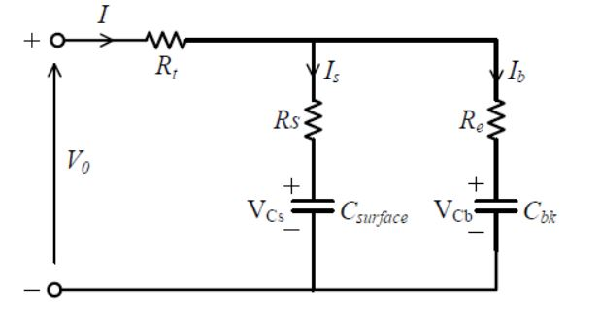
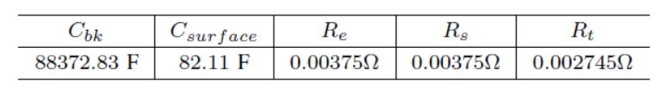
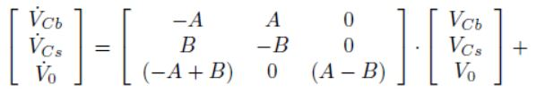
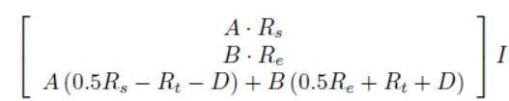
Kalman Filter MATLAB (Battery State)
bulk capacitor Cbk that acts as a energy storage component in the form of charge,
Capacitor- surface capacitance and diffusion(charge spread) effects within the cell Csurface
terminal resistance Rt, surface resistance Rs, and end resistance Re.
The voltages across both capacitors are denoted as VCb and VCs, respectively.
Vo – Output Voltage

Slide 10
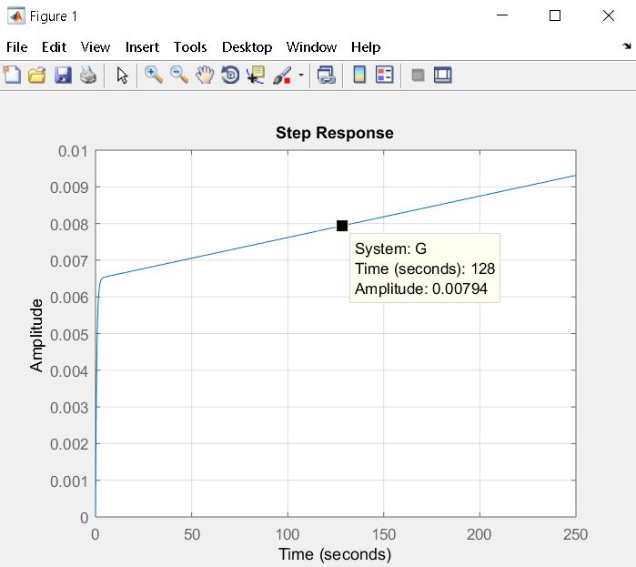
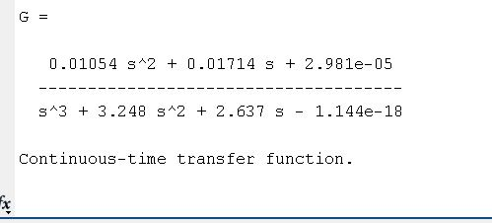
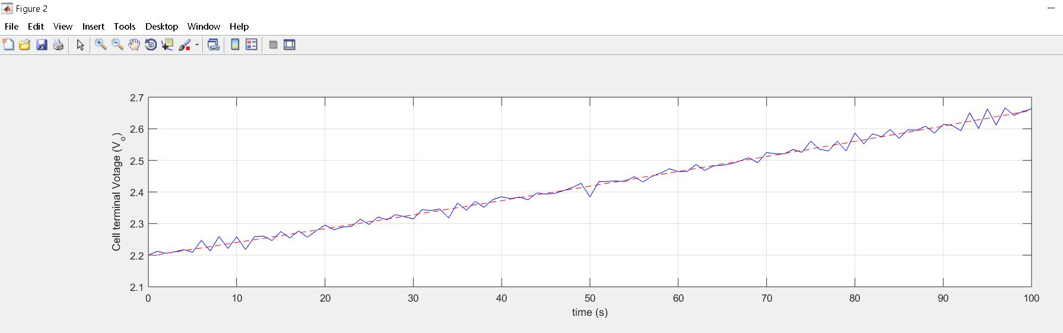
Kalman Filter MATLAB

Slide 11
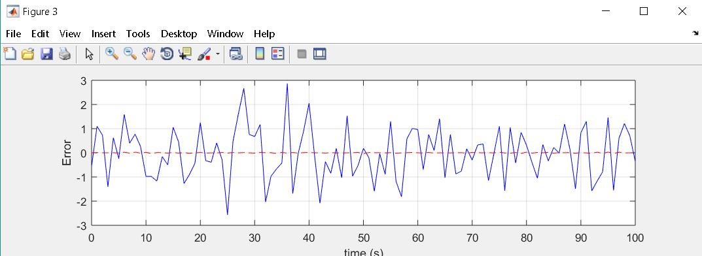
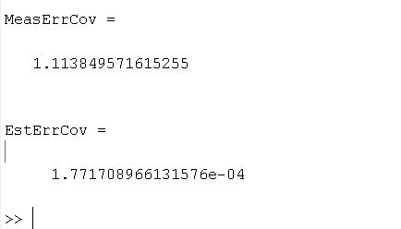
Kalman Filter MATLAB

Slide 12
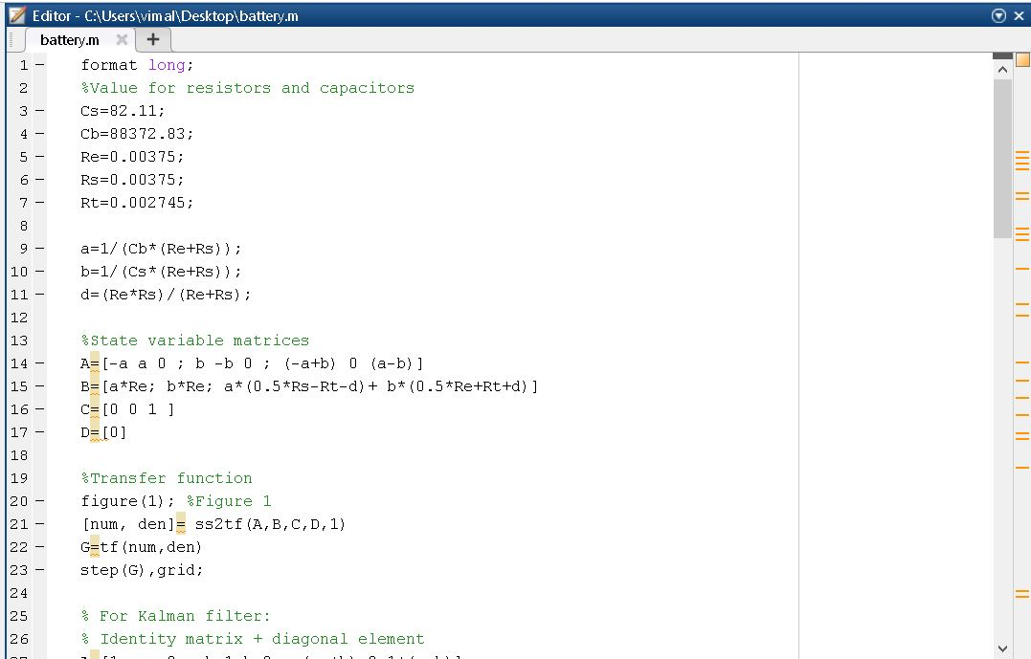
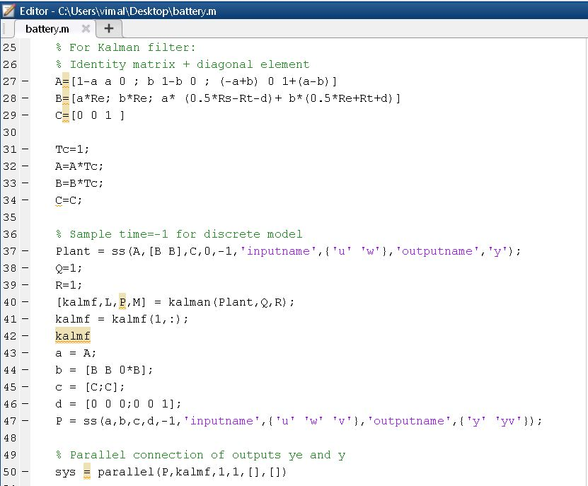
Kalman Filter MATLAB

Slide 13
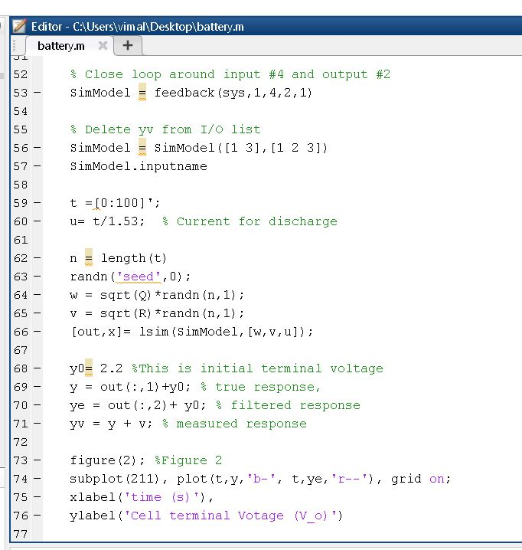
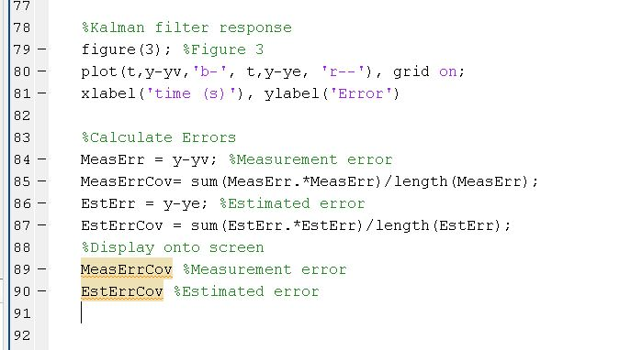
Kalman Filter MATLAB

Slide 14
References
[1] Welch, G and Bishop, G. 2001. “An introduction to the Kalman Filter”, [Online]. Available: http://www.cs.unc.edu/~welch/kalman/ [Accessed: 03- Apr- 2019].
[2]M. Hayes, Statistical digital signal processing and modeling. New Delhi: Wiley, 2014.
[3]"Visual Kalman Filter - Kalman filter designer for Windows", Luckhan.com, 2019. [Online]. Available: http://www.luckhan.com/kalman-filter-design.htm. [Accessed: 03- Apr- 2019].
[4] Ting, T., Man, K., Lim, E. and Leach, M. (2014). Tuning of Kalman Filter Parameters via Genetic Algorithm for State-of-Charge Estimation in Battery Management System. The Scientific World Journal, 2014, pp.1-11.

Slide 15
Thank You

